Slide 1

Linear Regression
Dr. Yuwadee Klomwises

Slide 2
Causation and Correlation
Causation
Correlation
One variable producing
an effect in another variable
Relationship between
two variables

Slide 3
Requirements for causation
Evidence of association between X and Y
X must occur before Y
No third factor driving both

Slide 4
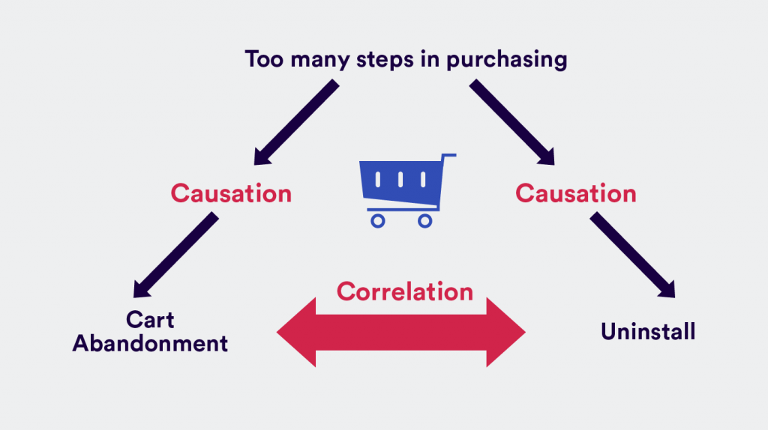

Slide 5
Correlation coefficients

Slide 6
How to explore the correlation between different types of variables
Dependent variable : Y
Categorical
Quantitative
Chi-square test | Analysis of Variance (ANOVA)
Chi-square test (transform quantitative to categorical) | Pearson correlation Spearman correlation Kendall correlation
Categorical
Exploratory
Variable: X
Quantitative

Slide 7
Correlation between quantitative variables
the strength of relationship between variables
Pearson correlation
Spearman correlation
Kendall correlation
Restrictions: continuous variable with normal distributed
Alternative for Pearson correlation
When assumptions are violated

Slide 8
Hypothesis testing for correlation
H₀ : The population correlation coefficient IS NOT
significantly different from zero
H₁ : The population correlation coefficient IS significantly
DIFFERENT FROM zero
Reject H₀ if p-value < significance level

Slide 9
Regression model depended on types of dependent variable
Linear regression
Logistic regression
Beta regression
Multinomial logistic regression
Poisson regression

Slide 10
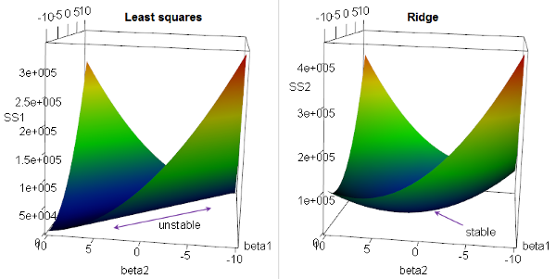
Regression model concerning complexity of optimization
Ridge regression
majorly used to prevent overfitting
works well even in presence of highly correlated features
Source: https://people.eecs.berkeley.edu/

Slide 11
Regression model concerning complexity of optimization
Lasso regression
performs feature selection:: some of the coefficients become exactly zero
selects any one independence variable among the highly correlated ones

Slide 12
Simple linear Regression

Slide 13
What is regression analysis?
Regression analysis is a way of mathematically sorting out which of those variables does indeed have an impact. It answers the questions:
Which factors matter most?
Which can we ignore?
How do those factors interact with each other?
How certain are we about all of these factors?
Source https://hbr.org/

Slide 14
What is regression analysis?
In regression analysis, those factors are called variables.
You have your dependent variable — the main factor that you’re trying to understand or predict such as monthly sales.
And then you have your independent variables — the factors you suspect have an impact on your dependent variable.
Source https://hbr.org/

Slide 15
Notation for data used in Regression analysis
Observation | Dependent variable | Independent variable
 | Y | X₁ | X₂ | … | X_{p}
1 | y₁ | x₁₁ | x₁₂ | … | x_{1p}
2 | y₂ | x₂₁ | x₂₂ | … | x_{2p}
 | … | … | … |  | …
n | y_{n} | x_{n1} | x_{n2} | … | x_{np}

Slide 16
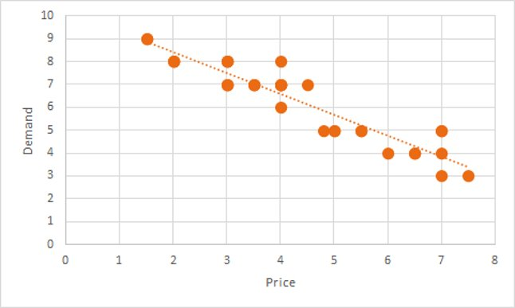
Model specification
In simple linear regression,
it assumes that there is approximately a linear relationship between X and Y.
Mathematically, we can write linear relationship between X and Y as

Slide 17
Model specification
the so-called coefficients of the variables
is the change in the predicted value of Y per unit of
change in X₁
the so-called intercept, is the prediction that the model would make if X₁ was zero

Slide 18
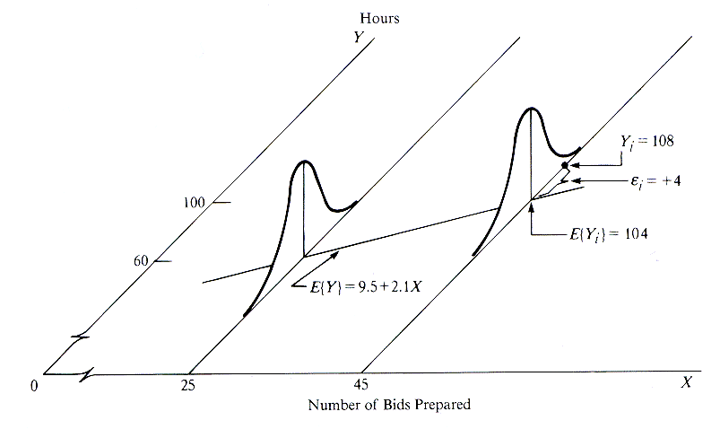
Source: http://www.unc.edu/~nielsen/soci709/m1/m1005.gif

Slide 19
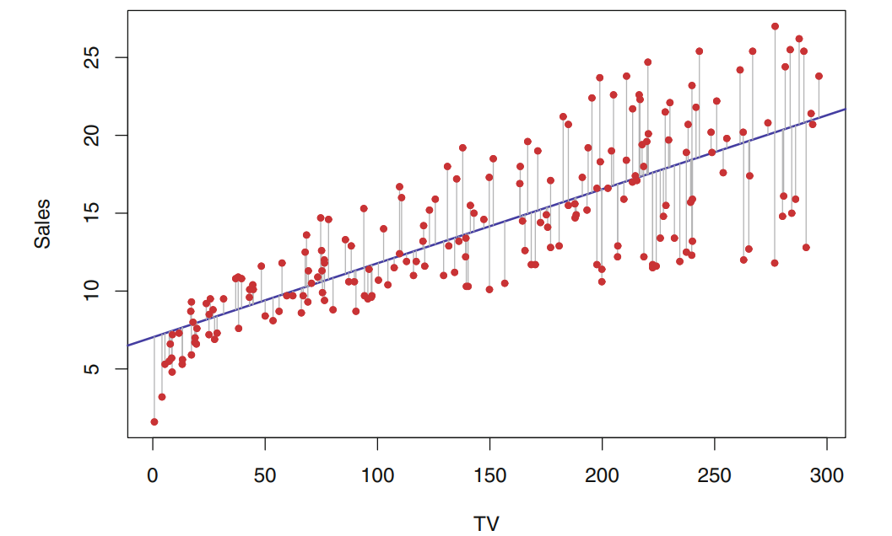
Parameter estimation

Slide 20
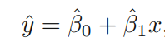
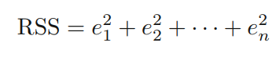
Parameter estimation
We define the residual sum of squares (RSS) as
The least squares approach chooses and to minimize the RSS.

Slide 21
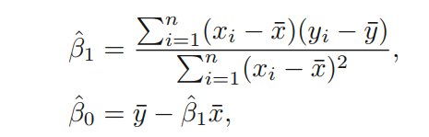
Parameter estimation
Using some calculus, one can show that the minimizers are

Slide 22
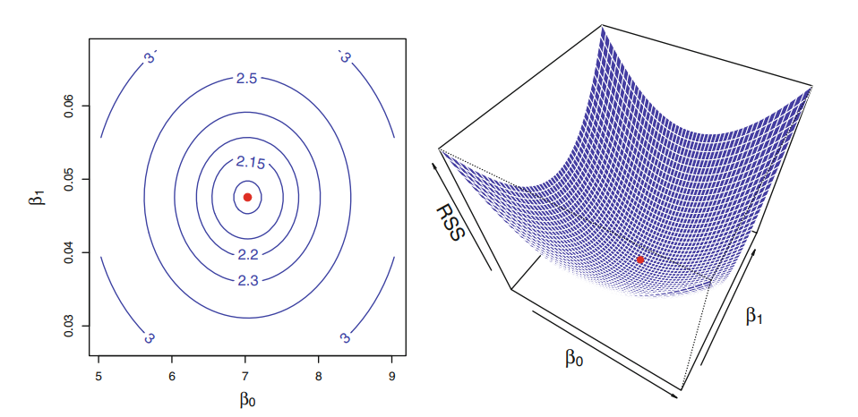
Parameter estimation

Slide 23
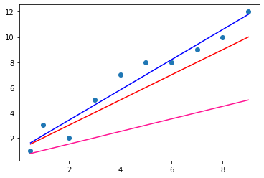
How to choose the best line

Slide 24
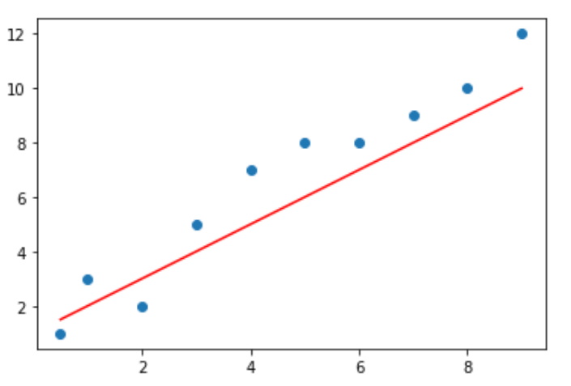
Cost of using specific line
price
size

Slide 25
Cost of using specific line
price
size

Slide 26
Finding solution for RSS

Slide 27
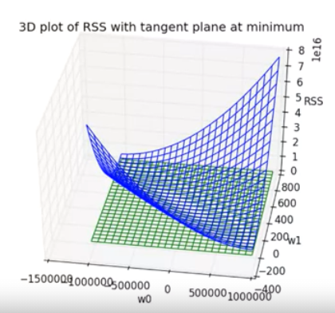
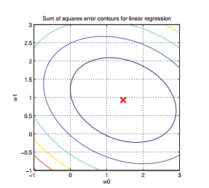
Defining Gradient of RSS

Slide 28
Defining Gradient of RSS

Slide 29
Defining Gradient of RSS

Slide 30
Closed form solution
Gradient descent

Slide 31
Closed form solution

Slide 32
Closed form solution

Slide 33
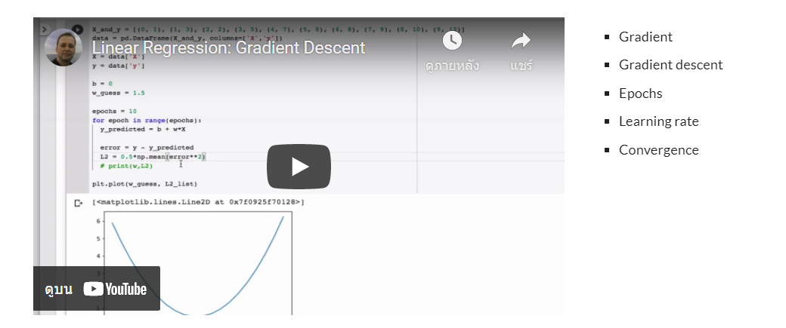
Optional reading
https://sites.google.com/view/ml-basics/linear-regression-and-gradient-descent

Slide 34
Assumptions in linear regression

Slide 35
Assumptions in linear regression
mostly based on predicted values and residuals
Linearity
Independence
Homogeneity of variance (homoscedasticity)
Normality

Slide 36
Assumptions in linear regression
Linearity
the relationships between the predictors and the outcome variable should be linear.
Big deal if violated.

Slide 37
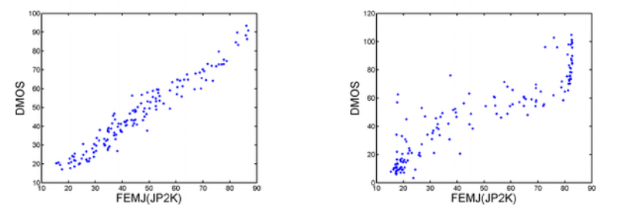
Linearity
source https://www.researchgate.net/profile/Ke-Gu-2

Slide 38
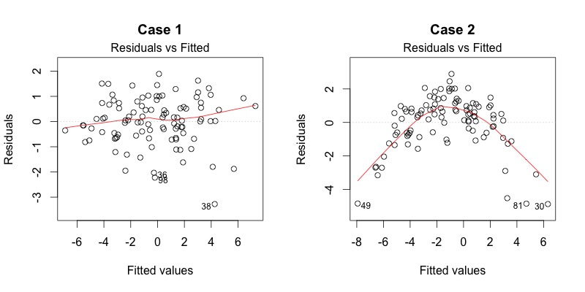
Linearity: : How to create diagnostic plot
residuals versus predicted values

Slide 39
Linearity: : How to fix
nonlinear transformation : if it appropriate
take natural log only to dependent variable
Y grows exponentially as a function of X
take natural log to dependent and independent variable
X has multiplicative effects on Y

Slide 40
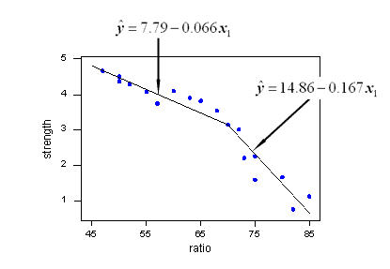
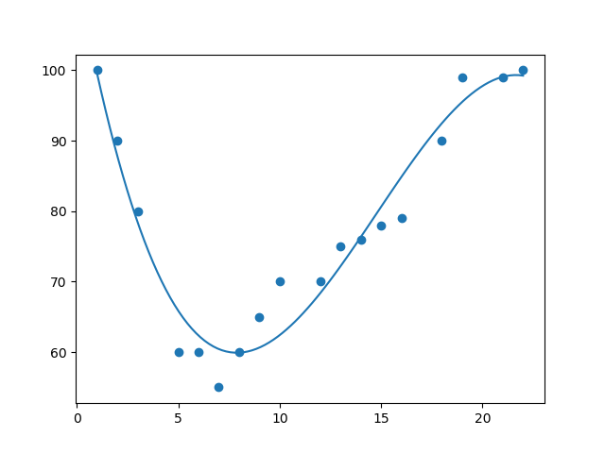
Linearity: : How to fix
artificially constructed variables (may lead to overfitting)
Polynomial regression
Piecewise Linear Regression
ที่มา https://online.stat.psu.edu/stat501/lesson/8/8.8

Slide 41
Assumptions in linear regression
Independence
no relationship among the residuals
no relationship between the residuals and independent variable
Huge deal if violated

Slide 42
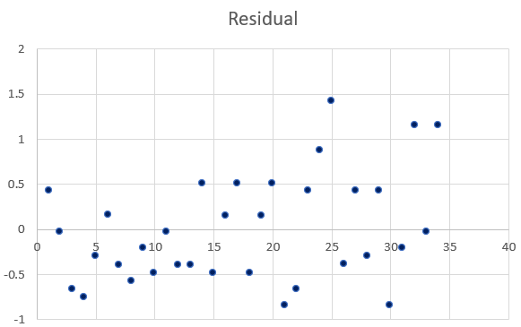
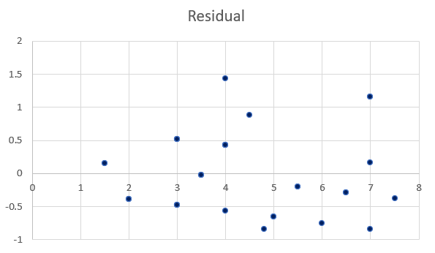
Independence: : How to create diagnostic plot
residuals versus row number
residuals versus independent variables

Slide 43
Independence: : How to use statistics
Durbin Watson (DW) statistic should be close to 2.0
This statistic will always be between 0 and 4.
The closer to 0 the statistic, the more evidence for positive serial correlation.
The closer to 4, the more evidence for negative serial correlation.
Alternative test: Ljung-Box test

Slide 44
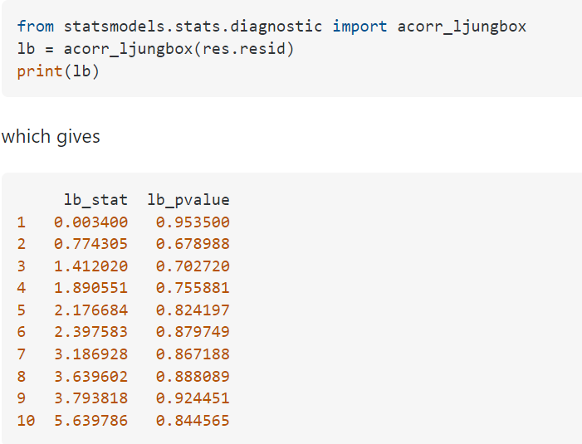
Ljung-Box test

Slide 45
Independence: : How to fix
If it due to
Violation of the linearity assumption
Omitted variable bias

Slide 46
Assumptions in linear regression
Homogeneity of variance (homoscedasticity)
the variance of error should be constant
Not as big deal if violated.

Slide 47
Homogeneity of variance:: How to create diagnostic plot
residuals (or standardized residual) versus predicted values

Slide 48
Homogeneity of variance:: How to create diagnostic plot
residuals versus independent variables

Slide 49
Homogeneity of variance : : How to use statistics
White Test
H₀: the errors are homoscedasticity (have constant variance) H₁: the errors are heteroscedasticity (have non-constant variance)
Reject H₀ if p-value is less than significant level

Slide 50
Homogeneity of variance:: How to fix
Relevance to
linearity assumption
Independent assumption

Slide 51
Assumptions in linear regression
Normality
the errors should be normally distributed – normality is necessary for defining test statistics for regression coefficients
Not as big deal if violated.

Slide 52
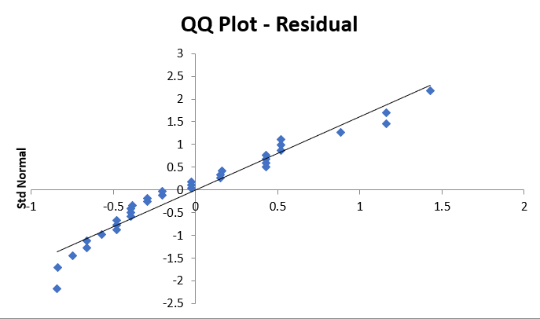
Normality: How to create diagnostic plot
Q-Q plot of residuals

Slide 53
Normality: How to do hypothesis testing
D'Agostino-Pearson test
based on skewness and kurtosis
Shapiro-Wilk test
does not work well when several values are identical
H₀: a dependent variable is normally distributed H₁: a dependent variable is not normally distributed
Reject H₀ if p-value is less than significant level

Slide 54
Normality:: How to fix
violations of normality often arise either because
non-normal distributions of the dependent and/or independent variables
violation of linearity assumption
In such cases, a nonlinear transformation of variables might cure both problems.

Slide 55
Normality:: How to fix
case separate models should be built
some data point should be excluded
if such events not likely to be repeated

Slide 56
In addition to assumptions, user should concern unusual and influential data
Outliers: observations with large residuals
Leverage: measures the extent to which the predictor differs from the mean of the predictor; the red residual has lower leverage than the blue residual
Influence: observations that have high leverage and are extreme outliers, changes coefficient estimates drastically if not included

Slide 57
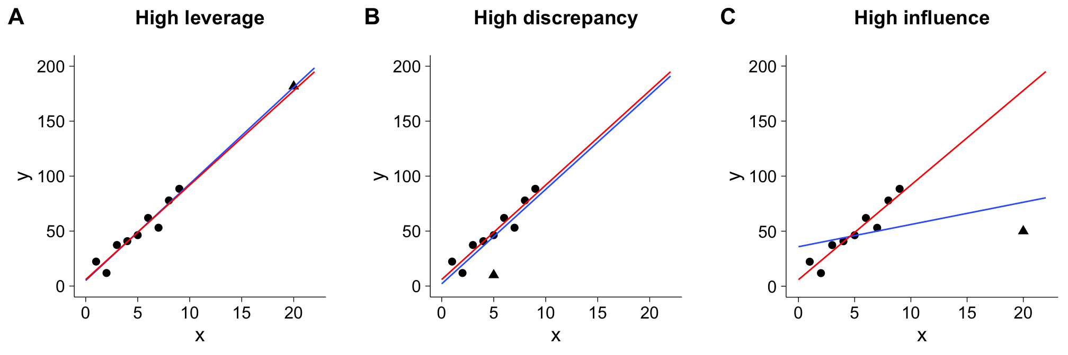
Leverage:
focus on value of x
Influence:
focus on slop of the line

Slide 58
How to measure the influence of each observation
Cook's distance
usage
measure of the influence of each observation on the regression coefficients.
extent of change in model estimates when that particular observation is omitted
when Cook's distance is close to 1 → highly influential data point
algorithm
interpretation

Slide 60
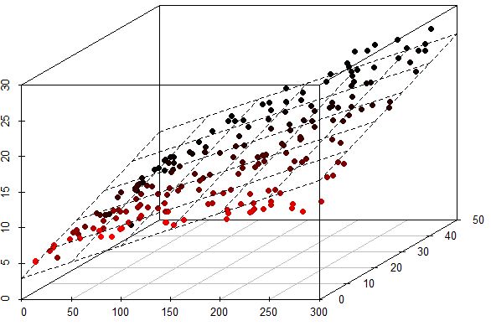
Multiple independent variables
source: http://www.d4t4v1z.com/

Slide 61
Vector and Matrix notation

Slide 62
Vector notation
Obs. | Y | Independent variable
 | Y | X₁ | X₂ | … | X_{p}
1 | y₁ | x₁₁ | x₁₂ | … | x_{1p}
2 | y₂ | x₂₁ | x₂₂ | … | x_{2p}
 | … | … | … |  | …
n | y_{n} | x_{n1} | x_{n2} | … | x_{np}

Slide 63
Vector notation
Obs. | Y | Independent variable
 | Y | X₀ | X₁ | X₂ | … | X_{p}
1 | y₁ | 1 | x₁₁ | x₁₂ | … | x_{1p}
2 | y₂ | 1 | x₂₁ | x₂₂ | … | x_{2p}
 | … |  | … | … |  | …
n | y_{n} | 1 | x_{n1} | x_{n2} | … | x_{np}

Slide 65
Matrix notation

Slide 66
More general expression
where is a non-linear transformation of the input
This model is still called linear model as model parameter appear only linearly.

Slide 67
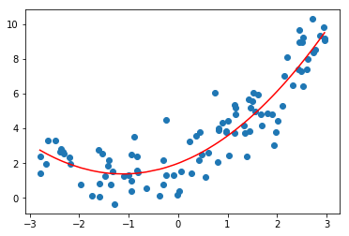
Example of non-linear transformation : Polynomial regression
where
This means that we “lift” the original one-dimensional input space into a (K+1)-dimensional feature space.

Slide 68
Cost function

Slide 69
Cost function

Slide 70
Cost function
Obs. | Y | Independent variable
 | Y | X₀ | X₁ | X₂ | … | X_{p}
1 | y₁ | 1 | x₁₁ | x₁₂ | … | x_{1p}
2 | y₂ | 1 | x₂₁ | x₂₂ | … | x_{2p}
 | … |  | … | … |  | …
n | y_{n} | 1 | x_{n1} | x_{n2} | … | x_{np}

Slide 71
Deriving the gradient

Slide 72
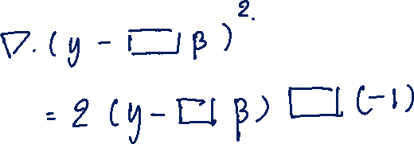

Slide 73
Closed form solution

Slide 74
Framework for model evaluation
Creating model
Evaluating model

Slide 75
Performance evaluation
Obs.

Slide 76
The bias-variance tradeoff

Slide 77
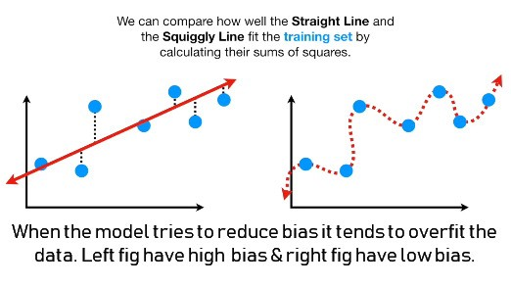
The bias-variance tradeoff
Low model complexity
High model complexity
High bias
Low bias
Low variance
High variance

Slide 78
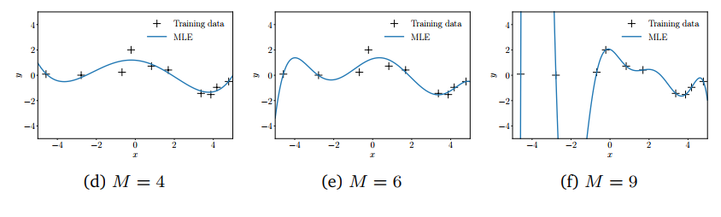
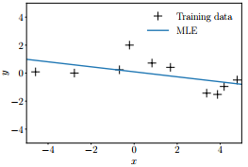
The bias-variance tradeoff
We notice that polynomials of low degree fit the training data poorly. When we go to higher-degree, it provide the better results of fitting.
Polynomial degree 1
Polynomial degree 6
Polynomial degree 9
Deisenroth, M. P., Faisal, A. A., & Ong, C. S. (2020). Mathematics for machine learning. Cambridge University Press.

Slide 79
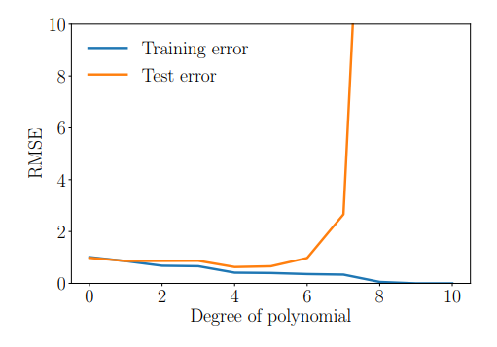
The bias-variance tradeoff
Deisenroth, M. P., Faisal, A. A., & Ong, C. S. (2020). Mathematics for machine learning. Cambridge University Press.

Slide 80
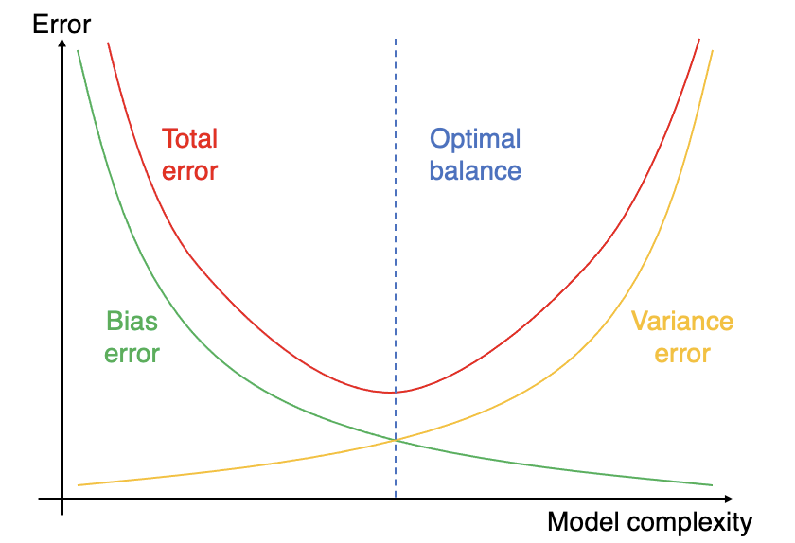
The bias-variance tradeoff
https://artsciencemillennial.substack.com/p/bias-variance-tradeoff-a-data-science

Slide 81
Ridge regression
When we increase the number of features, it can result in overfitting. To cope with this issue, the ridge regression introduces a penalty term by way of a tuning parameter called lambda. The idea is to make the fit small by making the residual sum or squares small plus adding a shrinkage penalty.

Slide 82
Cost function of ridge regression

Slide 83
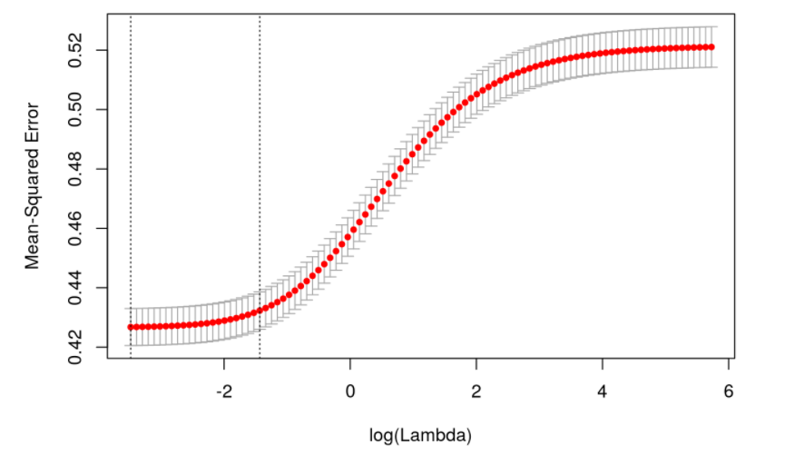
Tuning for penalty term
Source: http://wavedatalab.github.io/machinelearningwithr/post4.html

Slide 84
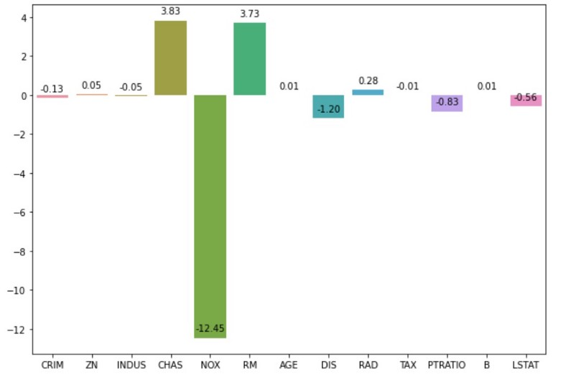
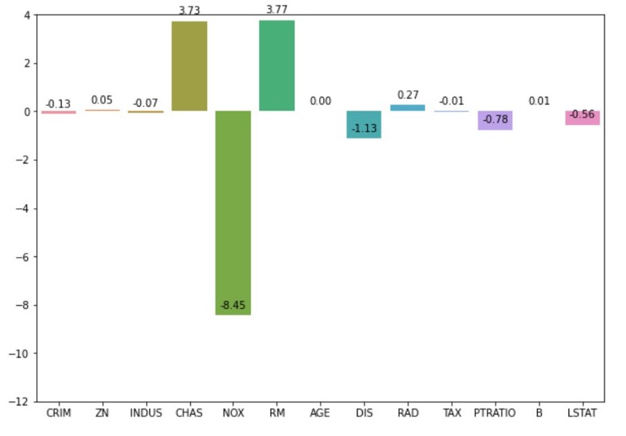
Magnitude of coefficients
Linear Regression
Ridge Regression
source: https://medium.com/geekculture/ridge-and-lasso-regression-51705b608fb9

Slide 85
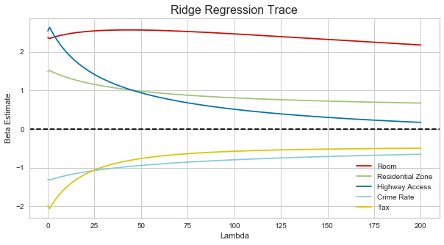
Ridge coefficients and lambda value
https://towardsdatascience.com/ridge-regression-for-better-usage-2f19b3a202db

Slide 86
Lasso regression
In lasso, the penalty is the sum of the absolute values of the coefficients. Lasso shrinks the coefficient estimates towards zero and it has the effect of setting variables exactly equal to zero when lambda is large enough while ridge does not. Hence, much like the best subset selection method, lasso performs variable selection.

Slide 87
Cost function of lasso regression
can be solved by coordinate descent

Slide 88
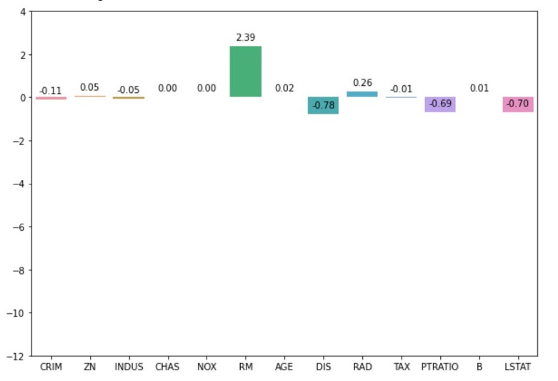
Magnitude of coefficients
Linear Regression
Lasso Regression
source: https://medium.com/geekculture/ridge-and-lasso-regression-51705b608fb9

Slide 89
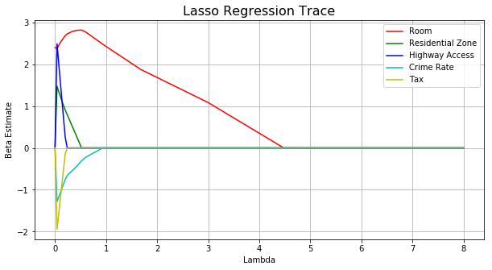
Lasso coefficients and lambda value
https://towardsdatascience.com/ridge-regression-for-better-usage-2f19b3a202db

Slide 90
Additional topic on linear regression

Slide 91
Log Transformations
In standard mathematical notation and in Excel
LN(X) is the natural log of X
LOG(X) is often used for the base-10 log
In statistics method and most of statistical software such as
R and SAS
the function that is called LOG is the natural log

Slide 92
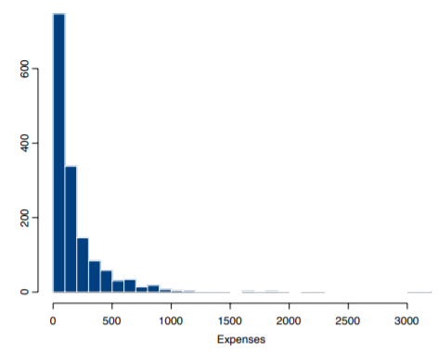
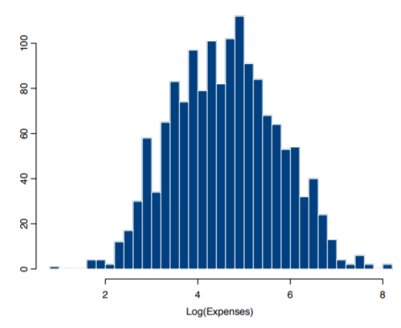
Why we employ Log transformations ?
ที่มา https://kenbenoit.net

Slide 93
Only the dependent/response variable is log-transformed.
Only independent/predictor variable(s) is log-transformed.
Both dependent/response variable and independent/predictor variable(s) are log-transformed.

Slide 94
Interpreting Log transformations in a linear model
Only the dependent/response variable is log-transformed
: log linear model
:one-unit increase in x₁ will produce an expected increase
in of units

Slide 95
Interpreting Log transformations in a linear model
Additive relationship
Multiplicative relationship
Ex.
One-unit increase in x₁
We add 1.22 to Y value.
We multiply exp(0.198) to Y value.

Slide 96
Interpreting Log transformations in a linear model
For every one-unit increase in sqft_living, price is multiplied by about 1.000417.

Slide 97
Interpreting Log transformations in a linear model
Only independent/predictor variable(s) is log-transformed
1% increase in the independent variable
increases (or decreases) the dependent variable by ( /100) units

Slide 99
Next Week

Slide 100

Practical guide to linear regression with Python
วิทยากร คุณภาคิน เตชธีรโภคิน
ตำแหน่ง Data Scientist
บริษัท ทรู คอร์ปอเรชั่น จำกัด (มหาชน)
ศิษย์เก่ารุ่นที่ 1 ของหลักสูตรวิทยาการข้อมูลและการวิเคราะห์

